Slide 1

Creating Websites with R

Slide 2

Motivation
“If you don’t have a website, do you really exit?”
-- Carlos Scheidegger

Slide 3

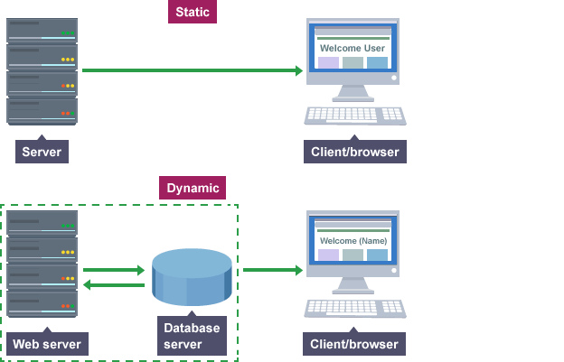
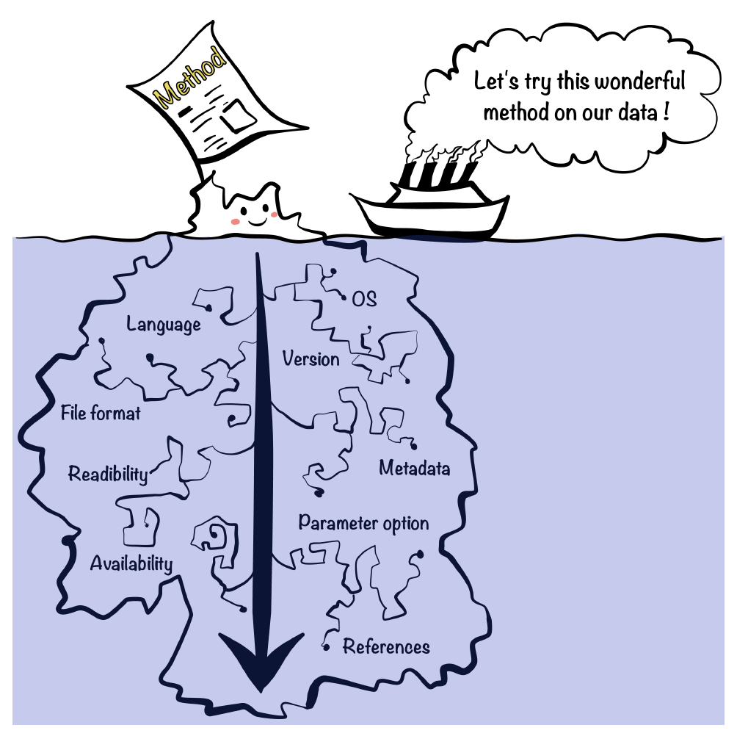
Why Blogdown?
Don’t Require Dynamic Content
R Markdown Docs
Portability
Reproducibility
Notes:
Don’t require dynamic content
Website is generated from R Markdown documents:
Portability: You can convert blogposts to pdf and publish to journals
Reproducibility
Support for technical documentation
This doesn’t mean your pages can’t change., but generally it means the server doesn’t have to “think” on them when the client requests them. Everyone sees the same thing: For website-savvy: you Don’t need to be bothered by server-side scripts or databases. A typical example of a dynamic site is a web forum. For example, each user has a profile page, but typically this does not mean the server has stored a different HTML profile page for every single user. Instead, the server will fetch the user data from a database, and render the profile page dynamically.
2: Create dynamic documents: results, tables, graphics, inline values can be computed and rendered dynamically from R code.
3: blogdown inherits HTML output from bookdown, so your can write LaTeX ath eqns, BibTex citations, theorems and proofs

Slide 4


Blogdown Workflow
Install
(Version 1.1.456)
install.packages (“blogdown”)
Create new (empty) Github repo

Slide 5
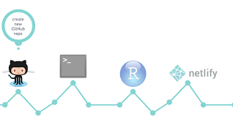
Blogdown Workflow
Create New Website
Publish
Website
Clone Repo to desktop

Slide 6
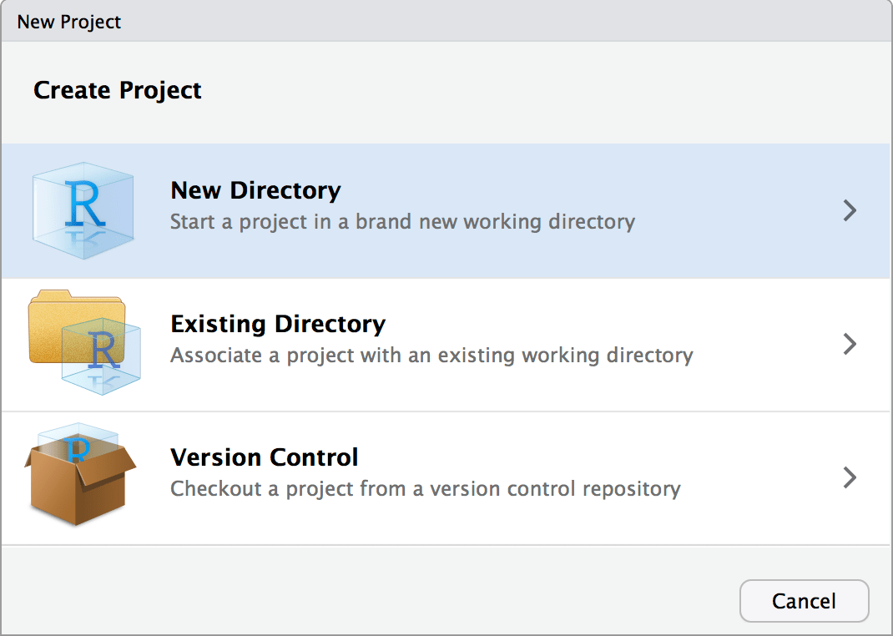

Slide 7
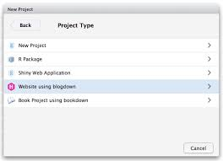

Slide 8
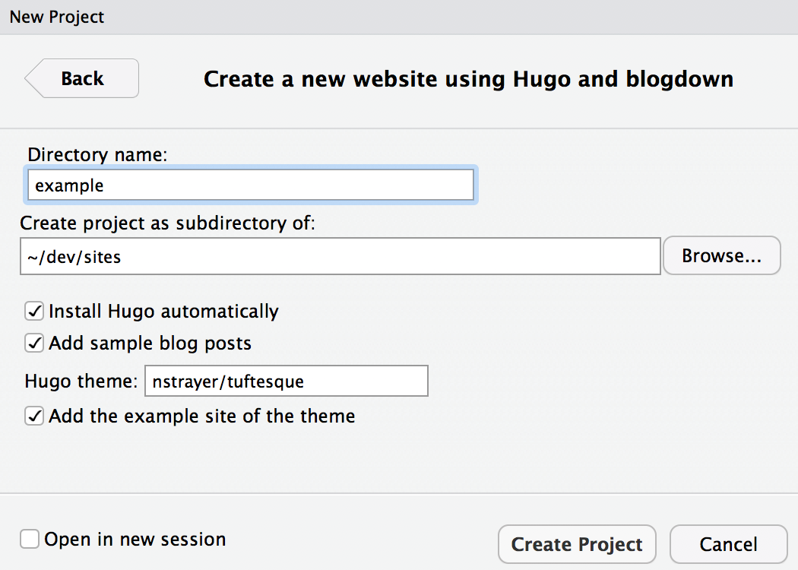
Repo Structure

Slide 9
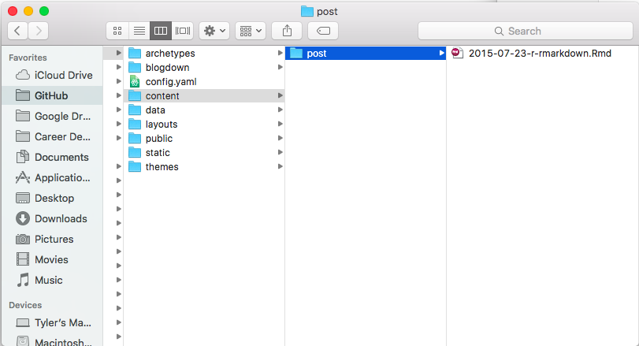
Repo Structure

Slide 10
Repo Structure

Slide 11
Blogdown Workflow
Stage: Commit:Push
to GitHub
Install
(Version 1.1.456)
install.packages (“blogdown”)
Create new (empty) Github repo
blogdown::build_site()

Slide 12
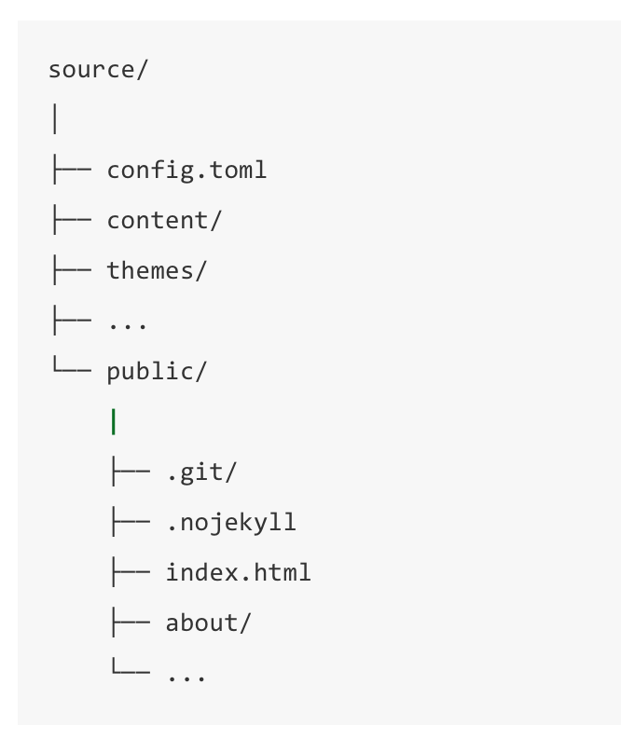
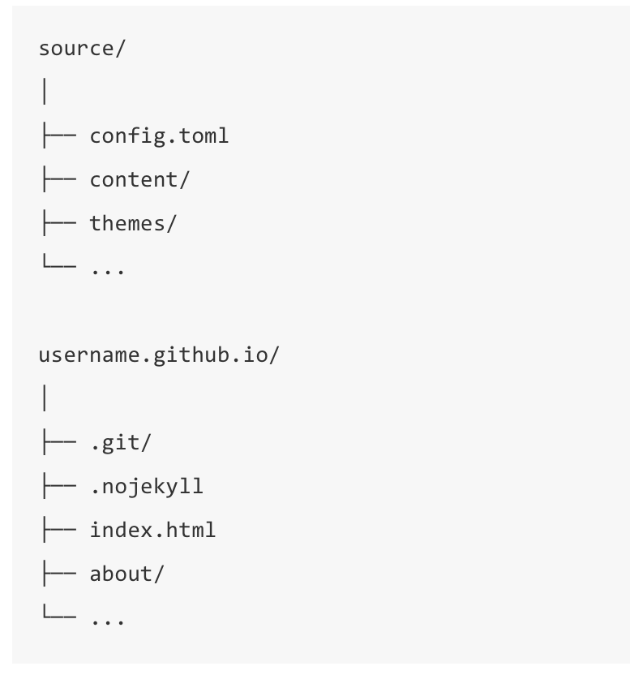
GitHub Structure

Slide 13

Publish!!!

Slide 14
Refrences
Making a Website Using Blogdown, Hugo & Github Pages: https://amber.rbind.io/blog/2016/12/19/creatingsite/#setting-up-github
Blogdown: https://bookdown.org/yihui/blogdown/github-pages.html

Slide 15
Workflow
Install necessary packages and software in R
Set up a new (empty) Github repository
Clone Github remote repo to your desktop and set this directory as your current working directory
Pick a hugo theme
Create the site in R using the blogdown package
Modify the website

Slide 16
Getting Started - Installation
Rstudio (Version 1.1.456)
Blogdown > install.packages (“blogdown”)
Static Site Generator -- Hugo > blogdown::install_hugo()
GitHub
Notes:
1.
2. Blogdown: package for R and Rstudio that helps you to create blog posts and other types of web content using the Rmarkdown language
Blogdown runs a static-site generator
3. Hugo is an open source static site generator: This means that instead of generating your website from scratch everytime someone visits your page, the pages are already made and ready to go when someone arries.
Yihui Xie

Slide 17
Building the Page
Notes:
New_site(): create the environment necessary for a new site
Serve_site(): allow syou to preview a working version of your site
Build_site(): compiles all .Rmd files into Hug—readable HTML & builds site

Slide 18
Troubleshooting

Slide 19
Quick Example
blogdown::newsite()
creates a new site(default themes, some sample posts, open them, build the site, and launch it in the RStudio Viewer, so you can immediately preview it.
blogdown::serve_site()
Notes:
1. this function to create a new site, download the default theme, add some sample posts, open them, build the site, and launch it in the RStudio Viewer, so you can immediately preview it.
2. LiveReload. This means your website⁵ will be automatically rebuilt and reloaded in your web browser⁶ when you modify any source file of your website and save it. Basically, once you launch the website in a web browser, you do not need to rebuild it explicitly anymore. All you need to do is edit the source files, such as R Markdown documents, and save them.

